Slide 1
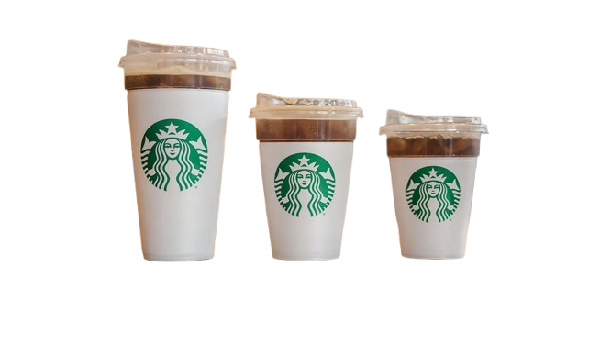
Branch Expansion Strategy for Starbucks Koramangala

Slide 2
Executive Summary:
The Starbucks Director is evaluating expansion opportunities for one of the three branches in Koramangala, Bangalore. With constraints on time and resources, a detailed analysis is required to identify the branch with the highest growth potential.
This study will focus on pinpointing key strategic priorities that, when implemented over the coming year, will maximize impact and provide measurable success to demonstrate to senior management.

Slide 3
Goals
Determine the branch most suitable for expansion to maximize revenue in the Koramangala locality.
Analyze sales, orders, and profits across all relevant variables.
Observe seasonal trends and surrounding factors to forecast next year’s performance.
Identify actionable focus areas to increase profits with minimal resource investment.
Visualize trends across products, platforms and time to uncover hidden opportunities and insights.
Evaluate operational efficiencies and customer preferences to streamline high-impact areas.

Slide 4

B.R.D.
Document Access:

Slide 5
Input Data & Data Transformation
The input data is derived from the Starbucks Koramangala branches for the year 2024, containing 192,947 rows.
Data is sourced from five tables representing sales, store details, product details, platform fee, and labour costs.
Tables Overview:
Sales: Transaction ID (PK), Date, Time, Quantity, Store ID (FK), Platform (FK), Unit Price, Product ID (FK)
Store Details: Store ID (PK), Store Address, Operational Cost, COGS Ratio
Product Details: Product ID (PK), Product Category, Product Type, Product Details
Platform Fee: Platform ID (PK), Platform Fee, Average Commission
Labour Cost: Time Bracket, Labour Cost
Column formats (e.g., date-time) have been standardised and relational integrity (PK-FK connections) are ensured.
Calculated fields (Total Sales, Gross Profit, Net Profit) are added for primary metrics in MySQL and Power BI.
A Date Table is created in Power BI to enable time-series analysis by isolating days, weeks, and months.
DAX measures are used in Power BI for advanced insights, such as seasonal trends, platform efficiency, and product profitability.
Server and Platforms: MySQL Workbench (localhost), PowerBI Desktop and DAX Studio

Slide 6
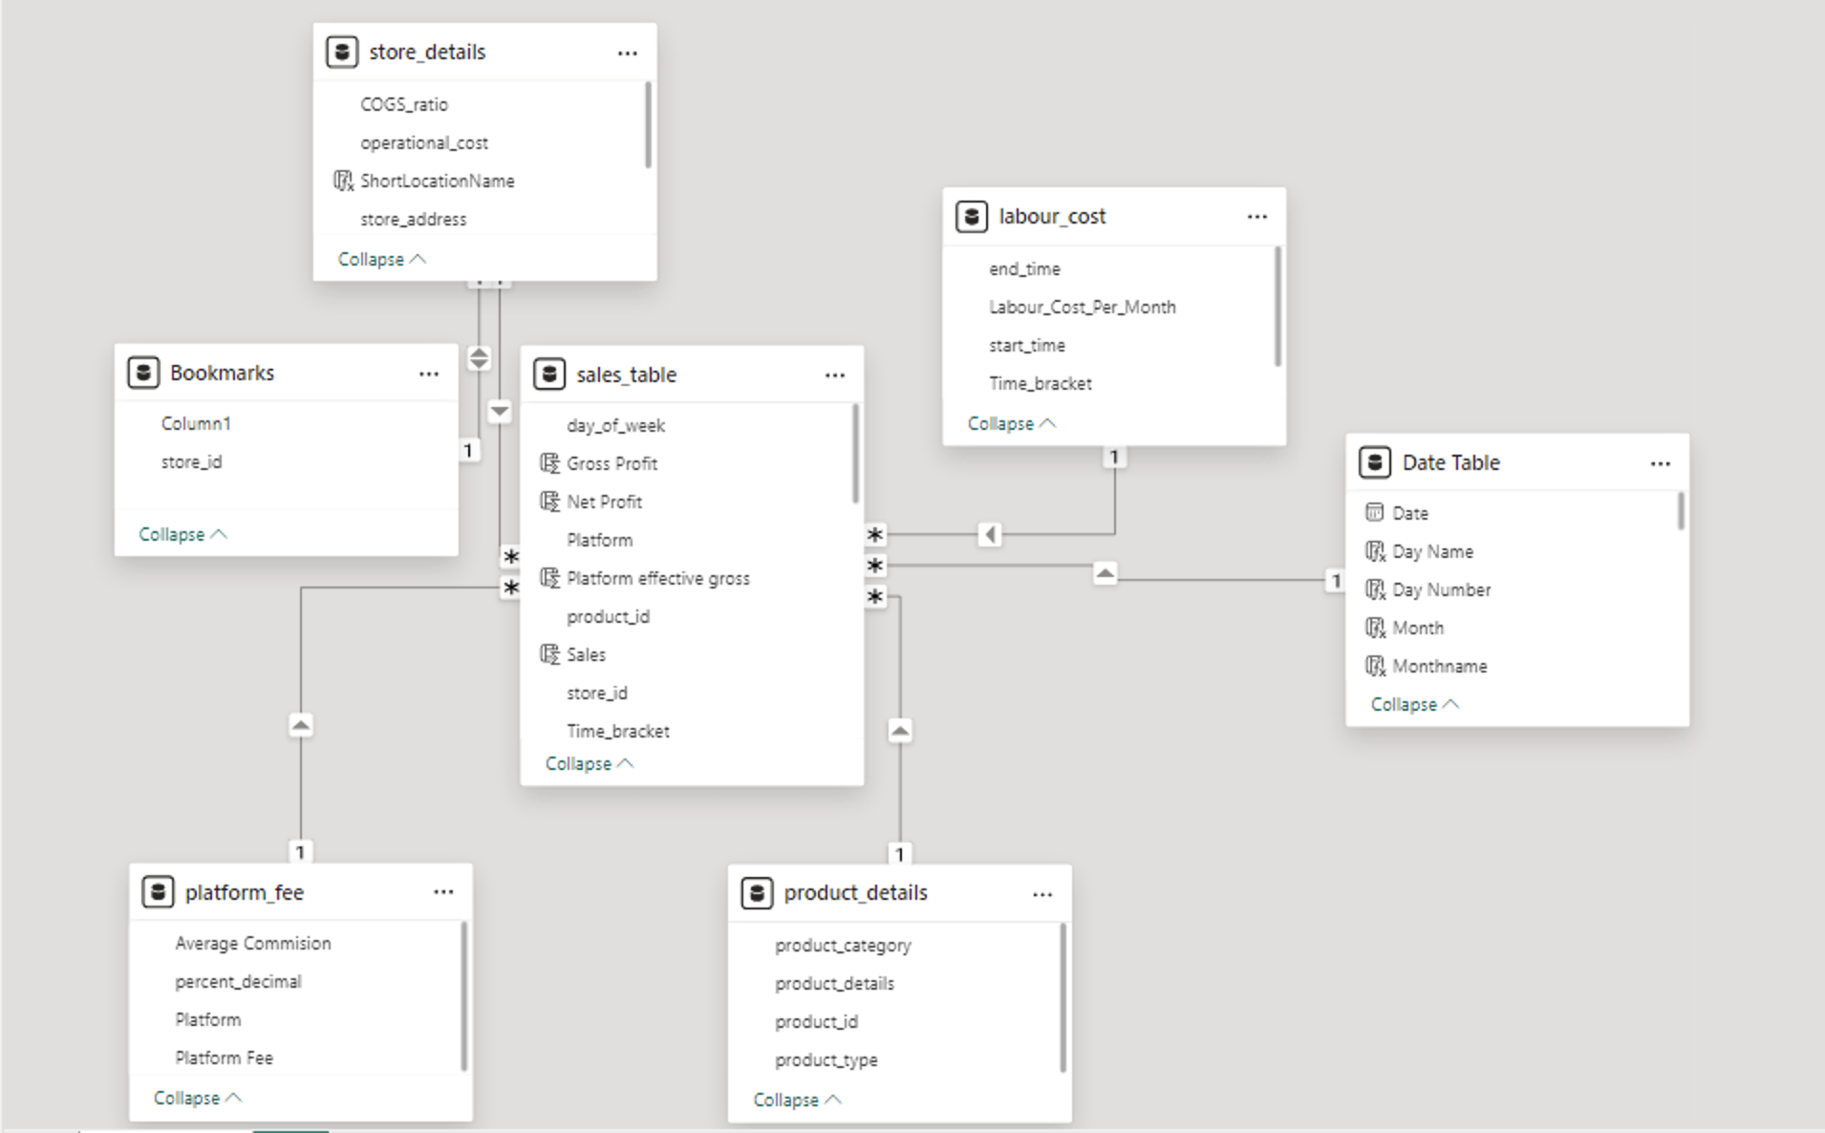
Table Relationships

Slide 7
Analysis
KPI REQUIREMENTS
1. Total Sales Analysis:
﻿﻿﻿﻿Determine the month-on-month increase or decrease in sales for each branch.
﻿﻿Calculate the difference in sales between the selected month and the previous month.
2. Total Orders Analysis:
﻿﻿﻿﻿Compare the month-on-month increase or decrease in the number of orders for each branch.
﻿﻿Calculate the difference in the number of orders between the selected month and the previous month.
Highest selling categories w.r.t. each branch, (w.r.t. time bracket.) / done
3. Total Quantity Sold Analysis:
﻿﻿Calculate the total quantity sold for each respective month per product category.
﻿﻿Determine the month-on-month increase or decrease in the total quantity sold for each product category.
﻿﻿Calculate the difference in the total quantity sold between the selected month and the previous month.
Most profitable branch
Products with highest return
Platforms + time slots to be boosted
Month dips + week dips
Surrounding influence
Most profitable category vs platform(from all 3)
My Ideas:
Maximum products sold
Repeated products sold for supply-chain
Time bracket impact for operational setup
Online platform growth over months vs area
Surrounding influence – upcoming projects and influencing industries
Predictive Analysis: Rising products (forecast in quantity and sales) (SEasONALITY INDICATORS)
Walk-in vs online sales trends

Slide 8
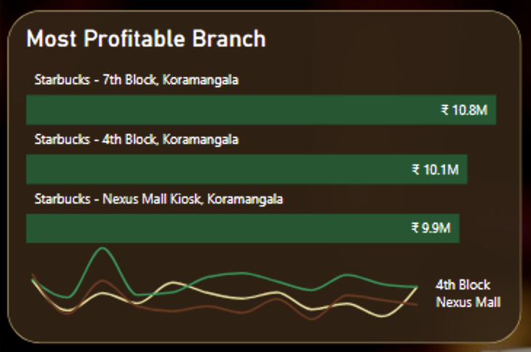
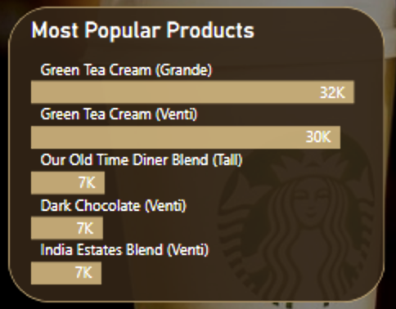
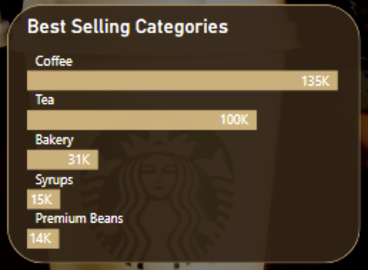

Slide 9
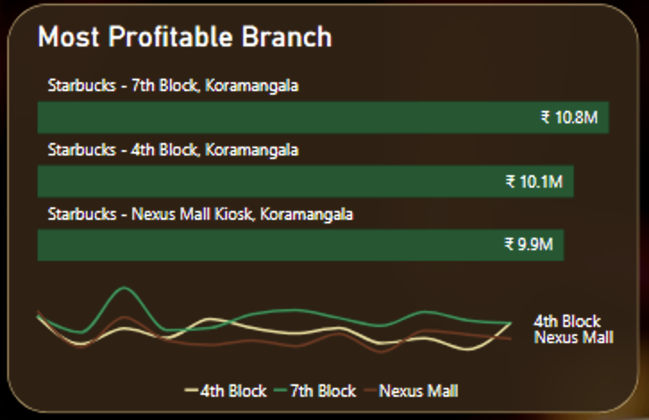
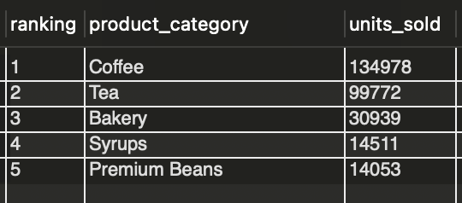
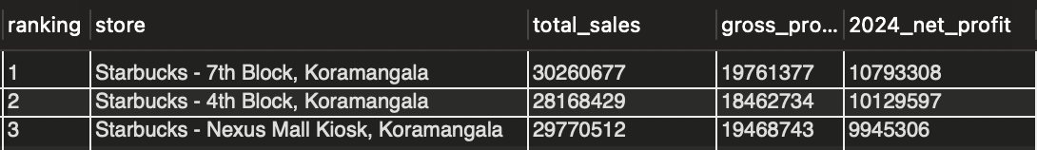
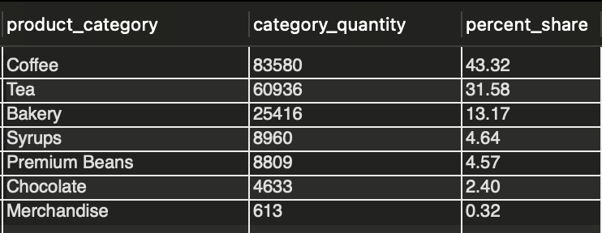
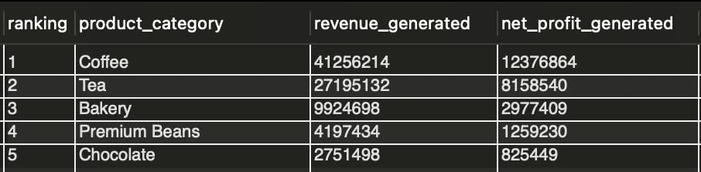
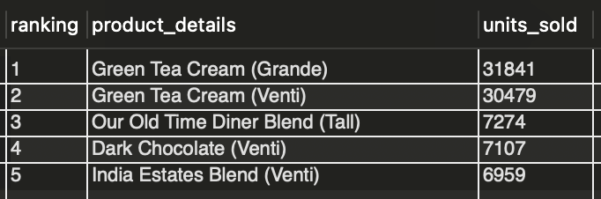
Performance Overview
Most profitable branch is 7th Block Koramangala, leading by Rs. 7 lakhs. It is also the most consistent throughout the months.
Top selling category is Coffee, followed by Tea, and they comprise 75% of the total units sold.
Most profitable category is Coffee with 51% higher returns than Tea. Bakery has a noteworthy contribution too.
Top selling item is Green Tea (Grande and Venti).

Slide 10
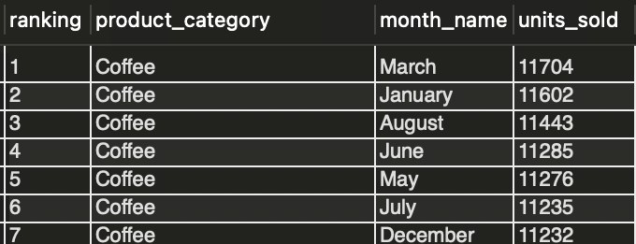
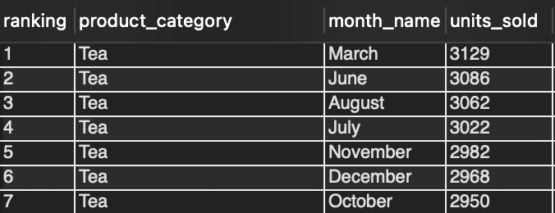
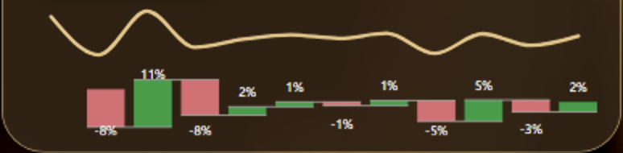
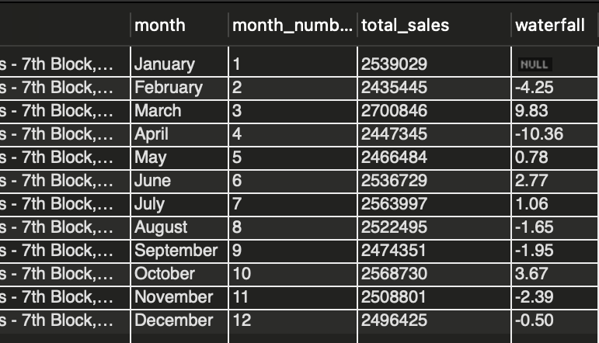
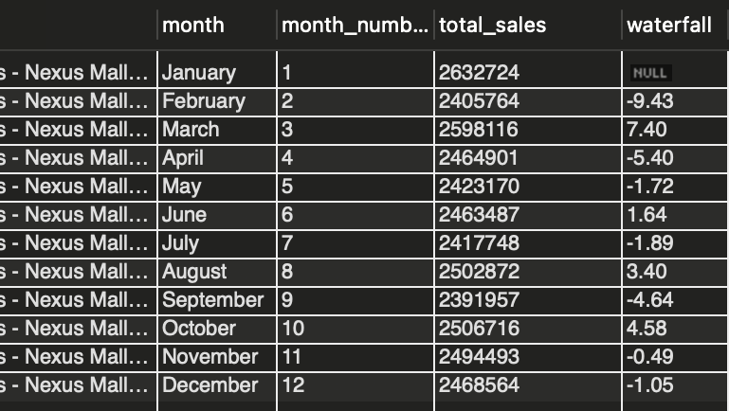
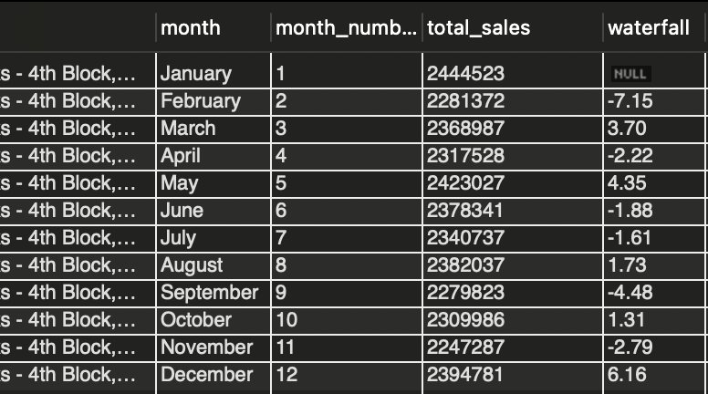
Monthly Peaks & Dips
Coffee & Tea collectively sell maximum during March, June & August.
February, April & September see a significant dip in sales, while March & October see a rise.

Slide 11
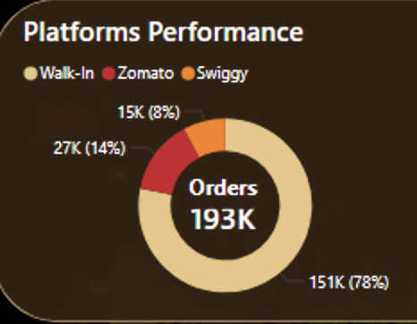
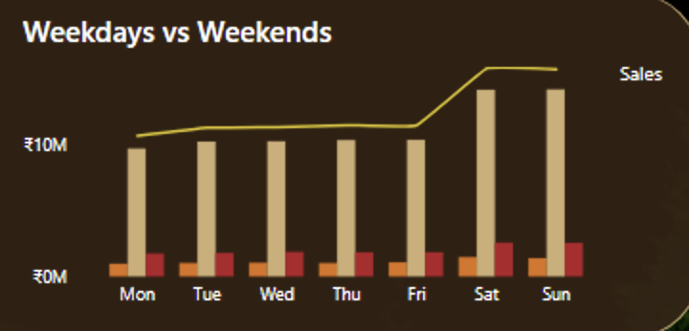
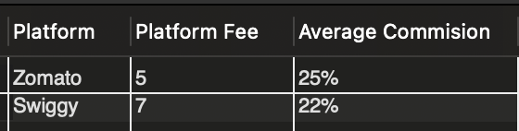
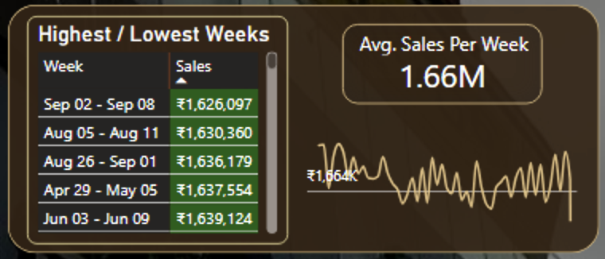
Trends and Opportunities
Zomato outperforms Swiggy with 85% higher online presence. A 50% online order boost from promotions and expanded radius could raise overall orders by 10%.
Weekends show stronger performance. With several nearby IT hubs, targeting corporates with exclusive offers presents significant potential.
Some of the lowest-performing weeks align with festivals like Ganesh Chaturthi. However, long holiday weeks surrounding Diwali and Christmas have not seen a significant dip.

Slide 12
Insight/solutions - why
How much profits can be generated?
Branch expansion profit, platform boost w.r.t. category, month boost w.r.t. category/product, something w.r.t. time
- Dip days or Week – holidays where north Indians return to their hometowns. Attract local population with native themed products and prices (comepete with local outlets)
Ways to increase profits?
Targeted Marketing.
Introduce local items to fill dips
Introduce corporate meeting bookings
Fill below average selling days
Market merchandise

Slide 13
Surrounding Impact
Kiosk to full outlet at the mall can increase traffic.
Nexus mall has competitive outlets offering premium coffee. Mcdonalds, Smoor, Food court.
Attracts groups and families.
Kiosk Not attractive for corporate crowd
Competitor alongside offers cheaper same products.
Capacities at road branches not fulfilled.
Attract corporate crowd for meetings and solo workspace.
New workspaces to be inaugurated in the 7th block area / 4th block area.
Competitors in the area:
Max – kiosk.
Medium – 4th block. (max online ordering considering residential area + offices)
Least – 7th block.

Slide 14
How will expansion of the same branch increase sales, compared to opening an entire new branch? People can already access the existing branch to its capacity.
Increased Capacity: Expansion allows the branch to serve more customers during peak hours, reducing wait times and accommodating higher foot traffic. Many branches lose potential sales simply because they hit capacity limits.
Enhanced Customer Experience: With additional seating, improved amenities, or diversified offerings (e.g., drive-thru, new menu items), the branch can attract repeat visits and increase the average spend per customer.
Established Customer Base: The existing branch already has loyal customers and a proven market demand. Expansion leverages this base without the need for costly new customer acquisition.
Lower Risk: Expanding a successful branch poses less risk than opening a new one, which requires establishing a location, building awareness, and managing unpredictable demand patterns.
Maximizing Operational Efficiency: Expanding leverages existing staff expertise, equipment, and supply chain networks, reducing overhead and initial costs compared to setting up a new branch.
Competitor Shielding: A larger branch presence in a high-demand area can deter competitors from entering the market, preserving market share.

Slide 15
Factors vs Impact
Market research and on-site branch visits were conducted to assess various factors that influence each branch’s sales performance. The following insights represent a synthesis of these observations, supported by profit evaluation:
Factors | 7th Block, Koramangala | 4th Block, Koramangala | Nexus Mall Kiosk
2024 Net Profits | HIGH | MEDIUM | LOW
Peak Hours | HIGH | MEDIUM | MEDIUM
Diversified Customer Experience | MEDIUM | MEDIUM | HIGH
Seasonal Deviation (MoM) | MEDIUM | MEDIUM | HIGH
Building Customer Loyalty | HIGH | MEDIUM | MEDIUM
Demand Patterns (Risk) | MEDIUM | LOW | HIGH
Maximizing Operational Efficiency | HIGH | MEDIUM | MEDIUM
Competitor Shielding | MEDIUM | LOW | HIGH
OPPORTUNITY | HIGH | MEDIUM-LOW | LOW

Slide 16
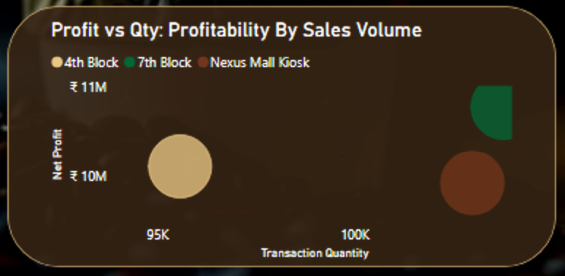
Branch-wise Summary
7th Block branch
Demonstrates the highest profitability and the most stable seasonal performance, making it a strong candidate for expansion. Its existing ability to handle peak-hour capacity and maintain high customer loyalty indicates further room for scaling. However, it also shows potential vulnerabilities to seasonal and competitive factors.
4th Block branch
Displays consistent but unremarkable metrics across various factors, with weaker performance characterized by smaller peaks and fewer high-gain months. While it’s less impacted by seasons and festivals, its moderate profits suggest lower demand or a suboptimal location, reducing its immediate potential for expansion.
Nexus Mall kiosk
Exhibits the highest fluctuations across key measures. Likely influenced by mall footfall and events, it faces challenges with low net profits and significant monthly deviations, making it a less ideal candidate for expansion. While its location within a shopping mall offers a diverse customer experience, complex strategies are needed to address its unpredictable demand patterns effectively.

Slide 17
Conclusion
Recommended branch for expansion:
Expansion of 7th Block branch shows the strongest recovery potential, with relatively consistent sales trends and higher spikes in growth months like March and October. Located in 8th block, it serves as a central hub for Koramangala residents, tourists and corporates, offering room to attract larger crowds with additional seating or services.
Actionable:
Offer promotions in slow months (April, February & September) to attract traffic in all the 3 branches.
Promote bundling options of high margin products (e.g., coffee or tea + bakery) or loyalty merchandise for repeat customers while boosting branding as a collateral.
Strategically invest in promotions on Zomato & Swiggy platforms to improve profit margins. Expand the serving radius for the expanding branch to maximize capacity utilization.
Introduce local menus at competitive rates (e.g., filter coffee or lemon tea blends) to tackle with migrating crowd during long holidays, and partnerships (e.g., with tech companies or colleges) to align with surrounding demographics.
Coupled with the above steps, this expansion could yield an estimated 25-30% increase in annual sales in 2025.

